Slide 1
Security in Wireless Cellular systems (focus limited to authentication, at this stage)

Slide 2
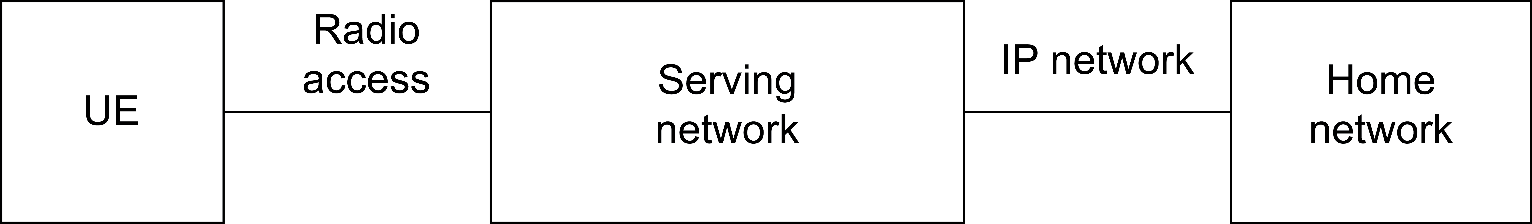

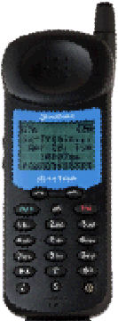
Architecture of wireless cellular systems (abstracted)
U_{u}
2/3G: MSC/VLR
4/5G: eNB/MME
2/3G: HLR/AuC
4G: HSS

Slide 3

Security in 1G
Security?
Nah…!

Slide 4



Security in 2G
Security? No problem!
Let me do it!!
Can you
Protect us?
COMP-128 Security by obscurity
No mutual auth (Rogue BS)
No core network security
. . . . . .

Slide 5
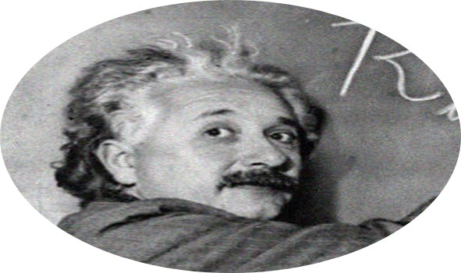

Security in 3G
OK, let’s be serious now…
Pro to the rescue!!
(fairly) good ciphers - public scrutiny!
Encryption AND (in part) Integrity
Multual authentication
Core network security
Multiple keys
. . . . . .

Slide 6
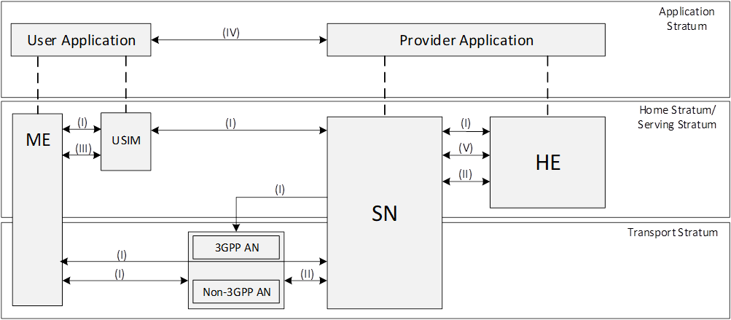


Security in 4G
Time for a Security architecture!
Systematic
approach

Slide 7
Security in 4G and 5G
Security in 4G
Time for a Security architecture!
Actually… this is already the 5G security architecture… to save one slide (couple of differences over 4G)!
(VI) Visibility and Configuration of Security
(III) User Domain Security
(V) Service-Based Architecture Domain Security
(IV) Application Domain Security
(I) Network Access Security
Systematic
approach
(I) Network Access Security
(II) Network Domain Security
(II) Network Domain Security

Slide 8
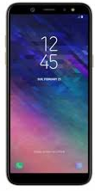
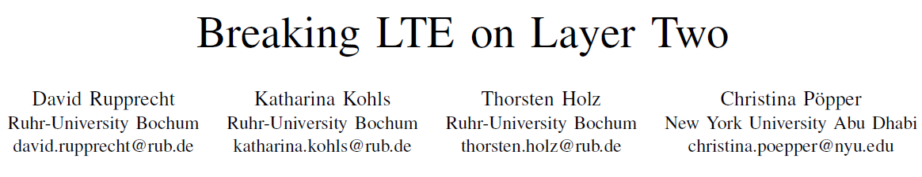
5G Security Architecture - Components
The 5G «vault» ☺: User data (UDR) and credentials (ARPF) used by UDM authentication/identification functions
Manage Network Access Security (AMF+SEAF co-implemented)
No security support in DU (deployed in untrusted sites)
Deconceals User Identity (more later)
Test Framework SCAS for Security Assurance
non3GPP access
N3IWF
S E P P
S E P P
ARPF
AMF
SEAF
AUSF
SIDF
UDM
Security for non-3GPP access (Wi-Fi, etc)
Implements UE authentication, stores key for later reuse
DU
CU
UDR
Improved AUTH and home control via Proof-of-Presence
gNB
Serving network
Home network
Access Stratum Security terminated at CU
There is IMHO NO such thing as a one-size trusted/untrusted 5G/6G network!
(my own technical explanation of why the geo-political security debate is in part ill-posed)
Security for interconnection traffic
Improved key derivation → several different levels of trust (trust domains)
L2 message integrity?
DU Distributed Unit
CU Central Unit
N3IWF Non 3GPP Inter Working Function
AMF Access Management Function
SEAF SEcurity Anchor Function
SEPP Security Edge Protection Proxy
AUSF AUthentication Server Function
SIDF Subscription Identifier Deconcealment Fct
ARPF Auth credential Repository & Processing Fct
UDM Unified Data Management
UDR Unified Data Repository

Slide 9
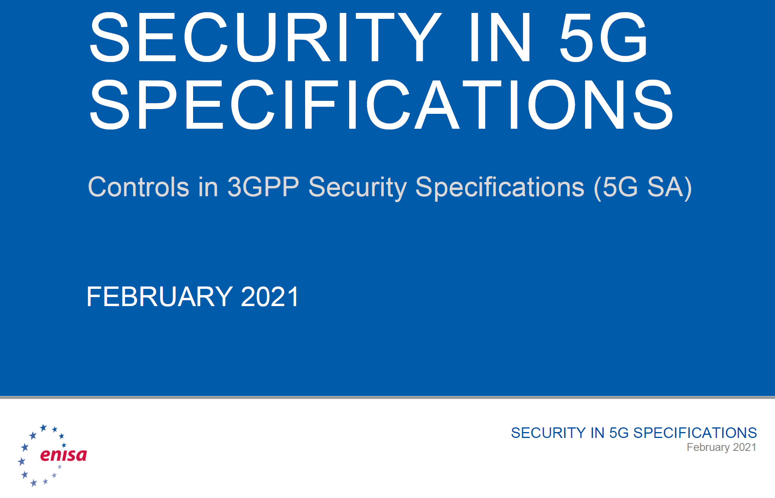
But systems are way more complex
Mobile/IoT security
Applications
5G/6G
systems’ security:
A small part of a bigger picture!!
Device manufacturing security
… … …
… … …
Hardware
Interworking
Firmware
Malware
… … …
Implementation
5G/6G security
… … …
… … …
Risk management
… … …
Side channels
Incremental deployment
… … …
No 5G security if
SW/HW implementation
is insecure!
Critical infrastructure = high tier threats
«They» might design vulnerabilities!
SW networks, third party suppliers: Complexity, increased threat surface!
Too many «optional/should»
In the standard!
Very risky! (you might believe you are secured, while…)

Slide 10
Challenge-Response authentication in Wireless Cellular systems

Slide 11
Authentication: when (e.g. 2/3G)
MS
BSS/MSC
VLR
HLR
AUC
Loc. Upd. Request
IMSI, LAI
Update Loc. Area
IMSI, LAI
Auth. Param. Req.
IMSI
Auth. Info. Req.
IMSI
Auth. Info
(Auth. Parameters)
Auth. Info
(Auth. Parameters)
authentication
Update Location
IMSI, MSRN
Start Ciphering
Kc
Activate ciphering
Insert Subscrib. Data
IMSI, additional data
Forward new TMSI
TMSI
Insert Subscrib. Data
ACK
Locat. Upd. Accept
IMSI
Locat. Upd. Accept
TMSI Realloc Cmd
Locat. Upd. Accept
TMSI Realloc ACK
TMSI ACK

Slide 12
Authentication in 2G (unilateral)
HN
SN
IMSI, RAND
Authentication Request
MS
SRES, Kc
Challenge: 128 bit RAND
Ki
RAND
A3
SRES
SRES
Equal?
Authentication Response
Signed RESult: 32 bit SRES
Ki
RAND
A8
Kc

Slide 13
Triplets (Authentication Vector)
VLR
IMSI
AuC
<RAND, SRES, Kc> x N
Home operator
Serving operator
Idea: once in a VLR area, autentication will need to be performed MANY times
Hence deliver N triplets, to be used for N distinct authentications
IMPORTANT: VLR does NOT need to know authentication algo used (A3, A8)
Triplet contains computed result by AuC
A3, A8 run inside the SIM (given by operator)

Slide 14
Authentication: details
Ki
128 bit secret
RAND
128 bit challenge
A38 = A3 and A8 at same time
SRES
32 bit
Kc
64 bits (well, 54 + ten 0s)
Deliberately weak?
Challenge response with:
Challenge → RAND
Secret → Ki
Hash → A3 algorithm

Slide 15
On the A3/A8 algorithms
Security by obscurity
A3 algorithm CAN BE operator-specific!
But most vendors originally used algo today called COMP128
Non disclosed but…
Reverse engineered? Leaked out?
COMP128 broken in 1998
http://www.isaac.cs.berkeley.edu/isaac/gsm-faq.html
Chosen challenge attack [1998, Briceno, Goldberg, Wagner]
Ki disclosed through about 150.000 queries with suitably selected challenges → approx 8h in 1998
Having Ki means cloning the card!
Better attack [2002, Rao, Rohatgi, Scherzer, Tinguely]
Less than 1 minute!
Lesson learned:
Security by obscurity does NOT work!! Leave hash design to crypto experts

Slide 16
Over the air attach
No mutual authentication!
Rogue BTS may easily perform the attach
run it for sufficient time

Slide 17
3G/4G/5G authentication: AKA Authentication and Key Agreement (STRONGLY Simplified for our purposes; 3G terminology)

Slide 18
Major differences with 2G
Mutual authentication!
Optimized…
Guaranteed freshness for auth parameters
More comprehensive security
More keys and several extra details
(we will not focus on this)
Algorithms FIRST scrutinized by research community, THEN selected
The opposite of security by obscurity ☺

Slide 19
Authentication Vector
VLR
IMSI
HLR /
AUC
MS
N x Auth Vector
RAND, AUTN
Auth
Network!
Authentication Vector:
- XRES (expected result) as GSM SRES
- RAND as GSM RAND
- AUTN (Netw. Auth. token) - - -
- CK (cipher key) as GSM Kc
- IK (integrity key) - - -
RES
=
XRES?
RES

Slide 20
MS authentication
Usual challenge response, but different (public) algorithm
K
RAND
K
RAND
K
RAND
f2
f3
f4
RES
32-128 bit
CK
Cipher key
128 bit
IK
Integrity Key
128 bit

Slide 21
Network Authentication
MS should send a nonce…
1 extra message
Bright idea: use Sequence number as “implicit” nonce!
Issue: MS and AuC must be (approx) synchronized
And robust procedures for resync must be specified
MS
VLR
HLR /
AUC
SQN-MS
SQN
SQN-HE

Slide 22
SEQ as nonce: idea
Current SQN-MS
stored
Check
SQN = SQN-MS + 1
(or in appropriate
Tolerance range to cope with lost msg)
SQN
(included in AUTN)
(given by AuC)
Use SQN as
“implicit” challenge!!
Once auth OK, update local SQN

Slide 23
Network authentication: AUTN format
SQN
Sequence number
AMF
Auth & key mgmt field
MAC-A
Message Auth code
48 bit
16 bit: carries info on which algo or key to use if choice available,
sync window, etc (signalling info)
64 bit: allows MS to verify authenticity of Network!
K
SQN
AMF
RAND
MS: has all info needed to check that MAC-A transmitted by network is the same of MAC-A locally computed!
SQN guarantees defense against replay
f1
MAC-A
64 bit

Slide 24
Minor detail: protecting SQN!
A privacy problem:
By looking at SQN (stepwise increasing), eavesdropper may discriminate and track user!
Solution: mask SQN with Anonymity Key
SQN xor AK
Sequence number
AMF
Auth & key mgmt field
MAC-A
Message Auth code
K
RAND
f5
AK
Anonymity Key
48 bit

